Slide 1

The Central Processing Unit:
What Goes on Inside the Computer
Chapter 2

Slide 2
Objectives
Identify the components of the central processing unit and how they work together and interact with memory
Describe how program instructions are executed by the computer
Explain how data is represented in the computer
Describe how the computer finds instructions and data
Describe the components of a microcomputer system unit’s motherboard
List the measures of computer processing speed and explain the approaches that increase speed

Slide 3
Contents
The CPU
Types of Storage
Executing Programs
Finding Data in Memory
The System Unit
Microprocessor
Semiconductor Memory
Bus Line
Speed and Power

Slide 4
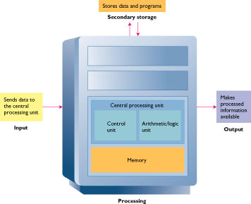
The CPU

Slide 5
The CPU
Converts data into information
Control center
Set of electronic circuitry that executes stored program instructions
Two parts
  Control Unit (CU)
  Arithmetic Logic Unit (ALU)

Slide 6
Control Unit
CU
Part of the hardware that is in-charge
Directs the computer system to execute stored program instructions
Communicates with other parts of the hardware

Slide 7
Arithmetic / Logic Unit
ALU
Performs arithmetic operations
Performs logical operations

Slide 8

Arithmetic Operations
+
Addition
Subtraction
Multiplication
Division
-
/
*

Slide 9


Logical Operations
NOT
Evaluates conditions
Makes comparisons
Can compare
  Numbers
  Letters
  Special characters
AND
OR
>
<
< >
>=
<=
=

Slide 10
Registers
Special-purpose
High-speed
Temporary storage
Located inside CPU
Instruction register
Holds instruction currently being executed
Data register
Holds data waiting to be processed
Holds results from processing

Slide 11
Types of Storage
Secondary
  Data that will eventually be used
  Long-term
Memory
  Data that will be used in the near future
  Temporary
  Faster access than storage
Registers
  Data immediately related to the operation being executed
  Faster access than memory

Slide 12
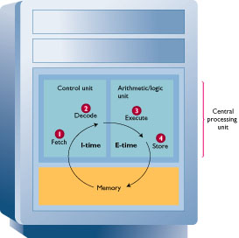
Executing Programs
CU gets an instruction and places it in memory
CU decodes the instruction
CU notifies the appropriate part of hardware to take action
Control is transferred to the appropriate part of hardware
Task is performed
Control is returned to the CU

Slide 13
Machine Cycle
I-time
CU fetches an instruction from memory and puts it into a register
CU decodes the instruction and determines the memory location of the data required

Slide 14
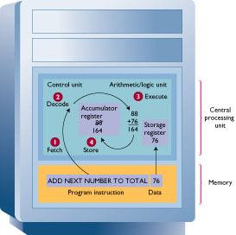
Machine Cycle
E-time
Execution
  CU moves the data from memory to registers in the ALU
  ALU is given control and executes the instruction
  Control returns to the CU
CU stores the result of the operation in memory or in a register

Slide 15
System Clock
System clock produces pulses at a fixed rate
Each pulse is one Machine Cycle
One program instruction may actually be several instructions to the CPU
Each CPU instruction will take one pulse
CPU has an instruction set – instructions that it can understand and process

Slide 16
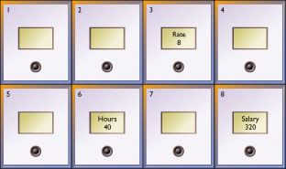
Finding Data in Memory
Each location in memory has a unique address
  Address never changes
  Contents may change
Memory location can hold one instruction or piece of data
Programmers use symbolic names

Slide 17
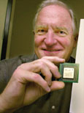
Microprocessor
CPU etched on a chip
Chip size is ¼ x ¼ inch
Composed of silicon
Contains millions of transistors
  Electronic switches that can allow current to pass through

Slide 18
Microprocessor Components
Control Unit – CU
Arithmetic / Logic Unit – ALU
Registers
System clock

Slide 19
Building a Better Microprocessor
Computers imprint circuitry onto microchips
  Cheaper
  Faster
Perform functions of other hardware
  Math coprocessor is now part of microprocessor
  Multimedia instructions are now part of microprocessor

Slide 20
Building a Better Microprocessor
The more functions that are combined on a microprocessor:
The faster the computer runs
The cheaper it is to make
The more reliable it is

Slide 21
Types of Microprocessors
Intel
Pentium
Celeron
Xeon and Itanium
Intel-compatible
Cyrix
AMD

Slide 22
Types of Microprocessors
PowerPC
  Cooperative efforts of Apple, IBM, and Motorola
  Used in Apple Macintosh family of PCs
  Found in servers and embedded systems
Alpha
  Manufactured by Compaq
  High-end servers and workstations

Slide 23
Speed and Power
What makes a computer fast?
Microprocessor speed
Bus line size
Availability of cache
Flash memory
Parallel processing

Slide 24
Computer Processing Speed
Time to execute an instruction
Millisecond
Microsecond
Nanosecond
  Modern computers
Picosecond
  In the future

Slide 25
Microprocessor Speed
Clock speed
  Megahertz (MHz)
  Gigahertz (GHz)
Number of instructions per second
  Millions of Instructions Per Second (MIPS)
Performance of complex mathematical operations
  One million floating-point operations per second (Megaflop )

Slide 26
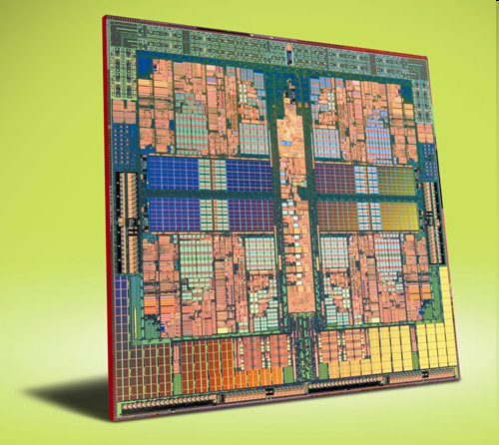
Multi-core processors

Slide 27
History
In the early 1970’s the first Microprocessor was developed by Intel.
It was a 4 bit machine that was named the 4004
The 4004 was followed by Intel’s 8008 and 8080, as well as motorola’s 6800 and 68000

Slide 28
Growth
With each new generation of processors there were several developments such as:
Smaller size
Faster
Increased heat dissipation
Greater Consumption of power

Slide 29
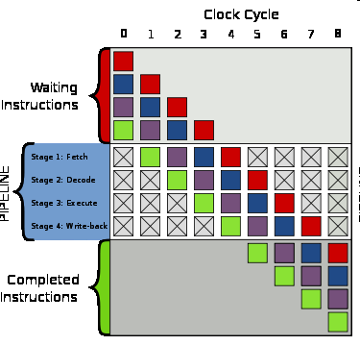
Single Core Performance
On technique used to increase single core performance was:
Pipelining: beginning other waiting instructions before the first finishes

Slide 30
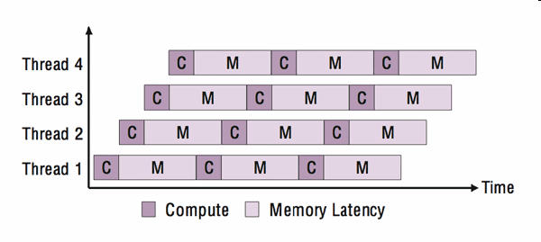
Single Core continued
Another technique was multithreading
Multithreading involves execution of two separate threads.
Time is divided and interlaced between the two threads in order to simulate simultaneous execution

Slide 31
Problems with Single Core
To execute the tasks faster you must increase the clock time.
Increasing clock times too high drastically increases power consumption and heat dissipation to extremely high levels, making the processor inefficient.

Slide 32
Multi Core solution
Creating two cores or more on the same Die increases processing power while keeping clock speeds at an efficient level.
A processor with 2 cores running at efficient clock speeds can process instructions with similar speed to a single core processor running at twice the clock speed, yet the dual core processor would still consume less energy.

Slide 33
Multi-Core Advantages
While working with many threads, a Multi Core processor with n cores can execute n threads simultaneously by assigning a core to each thread. If it must process more than n threads , say x, it can apply multithreading procedures with each core working with an average of x/n threads.
A Single core processor must multithread with every single thread.

Slide 34

Other Incentives
Improving an existing single core design or creating a better one is problematic in that it:
Is time consuming to design
Is risky to modify existing designs
Creating multi core processors is convenient in that:
The name “core dual” and similar names are good for marketing.
It has lower manufacturing costs.
Uses proven processor designs.

Slide 35
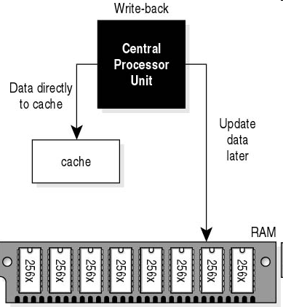
Implementations
Two main ways to have multiple cores interact are the shared memory model, and the distributed memory model.
In the shared memory model,
all cores share the same cache
memory.
In the distributed memory model,
each core has its own cache
memory.

Slide 36
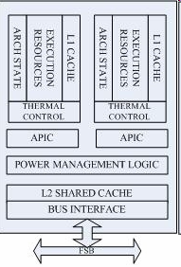
Implementations continued
The Intel core duo design
has a separate L1 cache
memory for each core, but
both cores share an L2
cache.

Slide 37
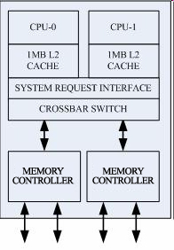
Implementations continued
The AMD Athlon 64 X2
implementation has
separate L1 and L2
cache memory for each
core.

Slide 38
Problems
Some of the current problems found with multi core processors include:
Memory/Cache coherence. As mentioned earlier, some implementations have distributed L1 caches but must share an L2 cache. This poses the problem of making sure each core keeps the other updated with changes in the data in its own cache.

Slide 39
Problems continued
Multi threading is also a problem when the software being run is not designed to take advantage of the multi core processor. This may mean that one core does most of the work which means that the processor is running no more efficiently than a single core.

Slide 40
Future of Multi Core
Current debates argue over whether future multi core processors should be homogenous or heterogenous.
That is, should all the cores be the same or should there be a mix of different types?

Slide 41
Future continued
Having all cores be the same makes production easier and keeps its complexity to a minimum.
Having different cores that are specialized in specific tasks increases complexity but has the potential to be much more efficient in speed and power consumption.

Slide 42
Instruction Sets
CISC Technology
  Complex Instruction Set Computing
  Conventional computers
  Many of the instructions are not used
RISC Technology
  Reduced Instruction Set Computing
  Small subset of instructions
  Increases speed
  Programs with few complex instructions
    Graphics
    Engineering

